Slide 1
Conversation Analysis: Interactional Cues
Charalambos Themistocleous

Slide 2
Conversation Analysis Talk-in-Interaction
Conversation analysts focus there attention on the “act” of conversation.
What is going on there?
How people interact?
What are the underlying principles of their interaction?
They try to answer these questions by making no reference to any evidence that comes outside the talk it self.

Slide 3
The CA practitioners say “it is not just unnecessary but illegitimate for an analyst to make use of information that the participants themselves have not chosen to ‘make relevant’ in their ongoing interaction” (Cameron, 2001:88).

Slide 4
The organization of turn-taking
Turn

Slide 5
One speaker speaks at a time.
Speaker change recurs.

Slide 6
Current speaker selects next speaker
Or if this mechanism does not operate, then…
Next speaker self-selects
Of if this mechanism does not operate, then…
Current speaker may (but does not have to) continue.

Slide 7
Transition Relevance Place (TRP)

Slide 8
Speech and words have literal meaning and of course no literal meaning:
Pragmatic
Conversational--Interactional

Slide 9
Prosody

Slide 10
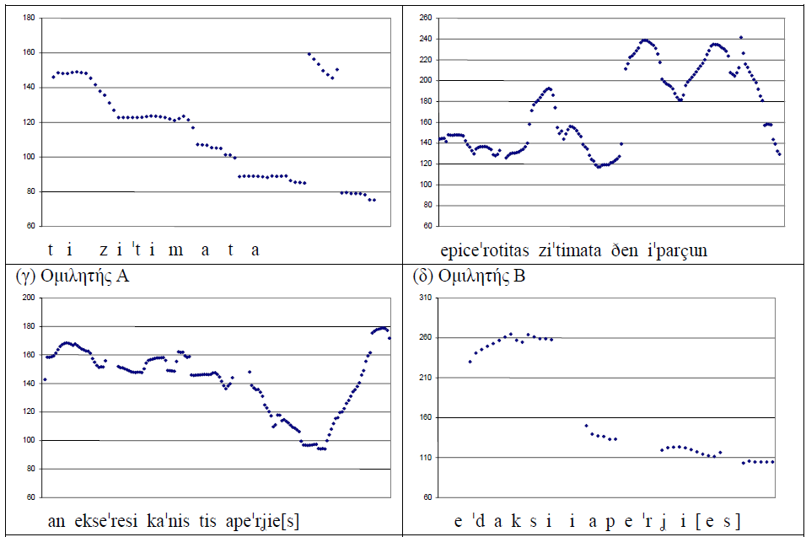
Exploiting Intonation

Slide 11
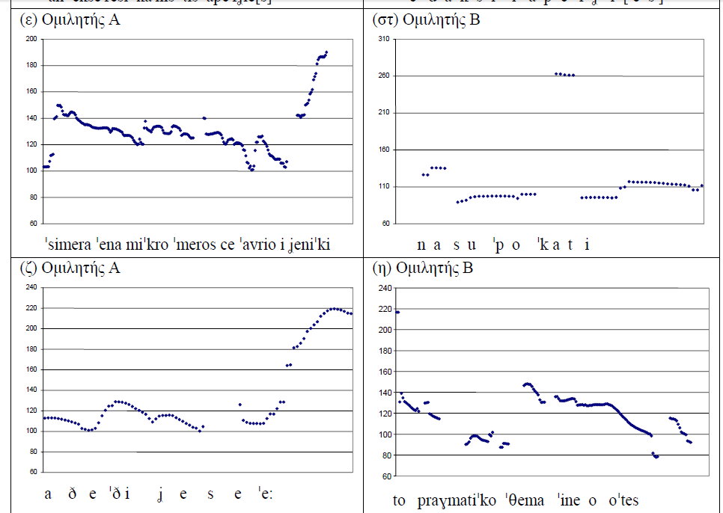

Slide 12
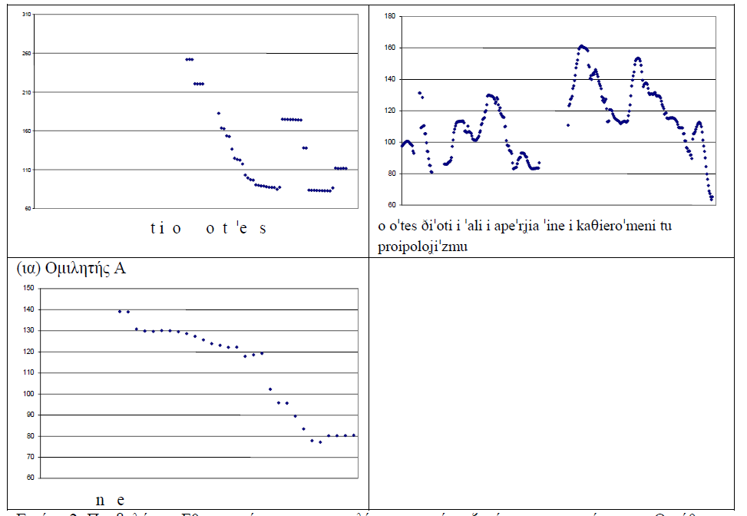

Slide 13
Siga: A case Study

Slide 14
(1)
(M=Melina; T=Thalis. M is trying on her new clothes (blouse and trousers) given to her as a gift by T. She first tried on the trousers.)
M itan na valo tʃe tim bluza:: mu alla exo llio meik ap
tʃe foume oti
enna ti llero::so. (.)
4. T→ siγa:: re.
5. Μ kala.
Translation
1. M I was going to try on my blou::se too but I’m afraid it’s going to get dirty:: from my make up. (.)
4. T→ siga:: re. 5. M okay.

Slide 15
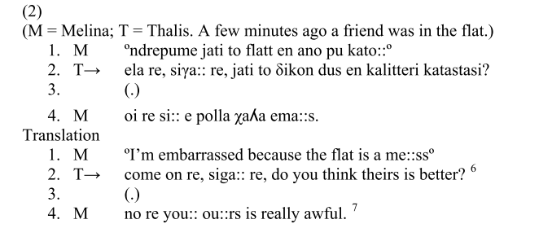

Slide 16
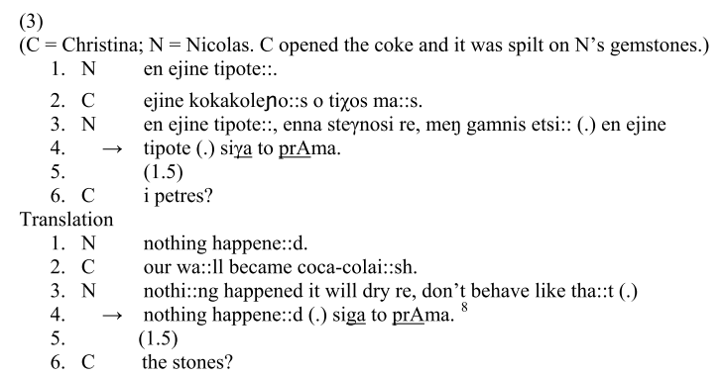

Slide 17
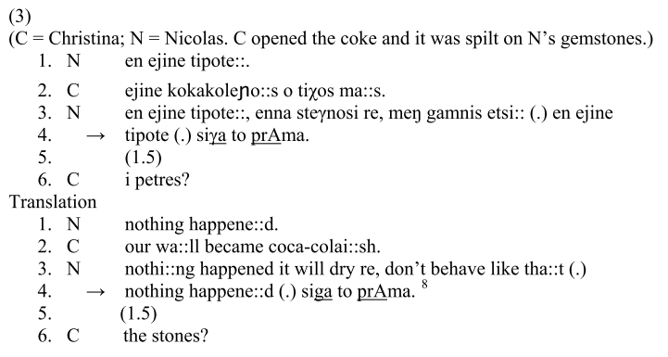

Slide 18
In extracts (1)-(3) siga and siga followed by re compose complete turn constructional units (TCUs) occurring in a different position in the turn.
In 1: 4 siga re is “free- standing”. The term “free-standing” proposed by Heritage (1984b: 302) is used to refer to a particle or a single word - in this case siga - which composes a turn on its own.
In 2: 2 siga occurs as a non-first TCU in a multi-unit turn and is followed by another TCU. In 3: 4 siga to prama occurs as the final TCU in a multi-component turn.

Slide 19
As will be shown later, siga is often used as a shortened form of the conventionalized ironic expression siga to prama.
An early observation about the turns in which siga occurs is that they come as responses to prior claims, assessments, or requests.
In the following sections, we will examine the use of freestanding siga/siga re/siga+address form, siga/siga re/siga+address form in non-first TCU position.

Slide 20
Freestanding siga, siga re and siga + address form
Now we will examine the use of siga, siga re and siga + address form as a response to prior claims, informing, evaluations and assessments.
I use the term assessment in a broad way as used by Pomerantz (1984: 63), who assesses that an initial assessment proffered by a speaker accomplishes actions such as praise, complaint, compliment, insult, self-deprecation.
The next relevant action accomplished by the recipient is agreement or disagreement with the prior assessment (id.).

Slide 21
Siga, Siga re: Freestanding Challenge
In the following extracts siga/siga re is used to challenge in an ironic conventionalized way what is said in the prior speaker’s turn.
What is challenged with siga/siga re is usually the factuality/truth/accuracy of what is said in the prior speaker’s turn by showing skepticism.
This use of siga/siga re is shown with the arrowed turns in the following extracts:

Slide 22
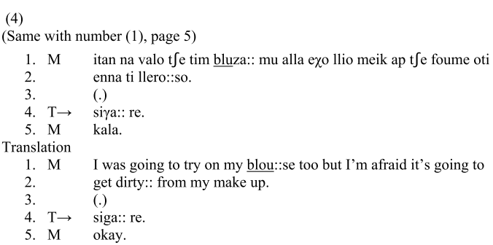

Slide 23
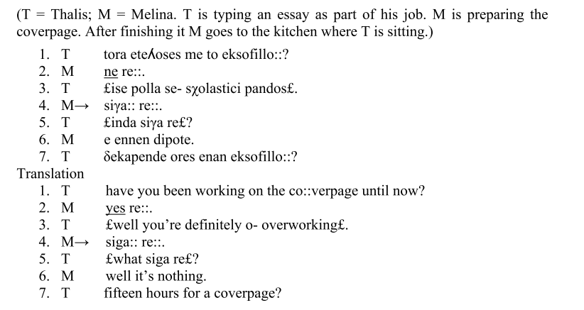

Slide 24
Siga +address form: Freestanding Challenge
Although siga in the data is commonly followed by re, it is also, though less often, followed by address forms. With reference to the data, the use of an address form may consist of the particle re + addressee’s first name or of an address term + first person singular possessive pronoun. It can be argued that in the following extracts in a similar vein with the use of
siga re, siga + address form is also used to challenge what is said in the prior speaker’s turn by ironically criticising and rejecting it. This is illustrated with the arrowed turns:

Slide 25
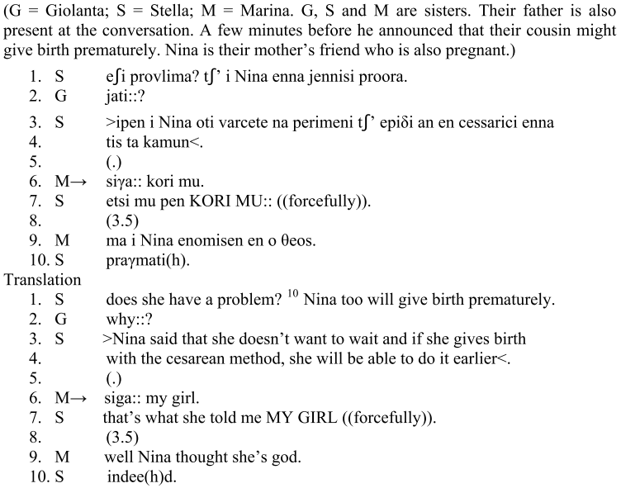

Slide 26
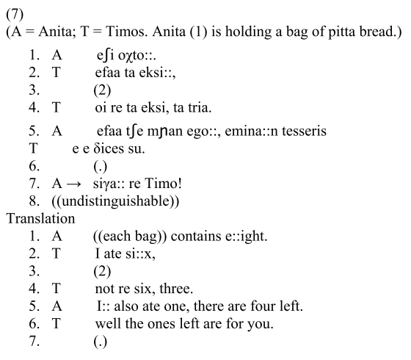

Slide 27
Siga, siga re: Non-first TCU Making the disagreement/challenge overt
According to Pomerantz “(s)econd assessments are assessments produced by recipients of prior assessments in which the referents in the second are the same as those in the prior” (1984: 59).
In the following two extracts, the speaker makes an assessment and the recipient proffers a second assessment which is in disagreement with the prior one.
The disagreement is proffered through a multi-component turn. Siga/siga re is used as a non- first TCU in order to reinforce the disagreement/challenge/rejection by making an ironic evaluation of what is said in the prior turn. Siga/siga re is followed by another TCU which also expands on the disagreement. The extracts that follow serve to illustrate this point:

Slide 28

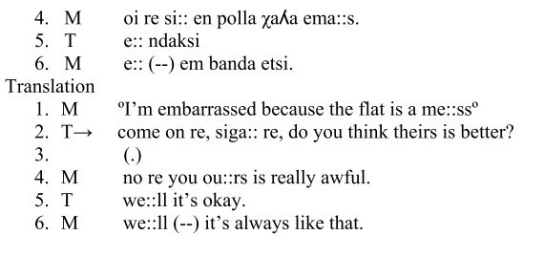

Slide 29
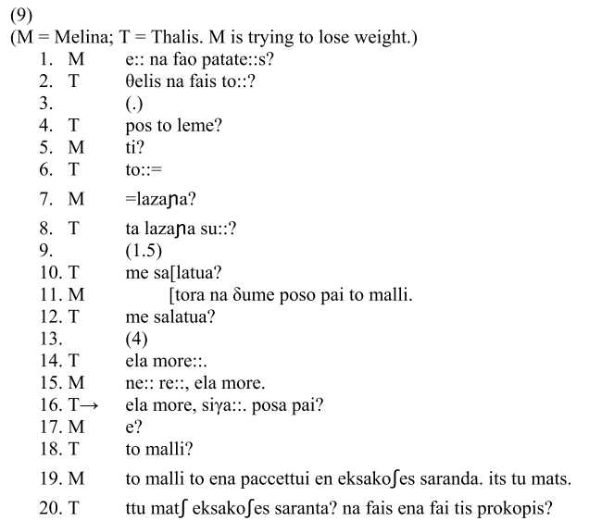

Slide 30
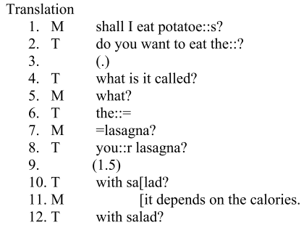
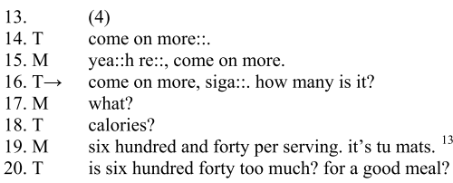

Slide 31
In sum, siga/siga re occurs in non-first TCU position in turns that are in disagreement with prior assessments which serve as claims, complaints etc.
That is, after a first assessment the recipient responds with a multi-component turn.
The first TCU of that turn expresses disagreement with the assessment.
This is followed by a second TCU composed of siga/siga re which reinforces the disagreement by doing insistence and at the same time ironically evaluates the prior assessment.
Siga/siga re is followed by another TCU which expands on the disagreement.
It seems that siga/siga re is the most emphatic component of the disagreement/challenge expressed with multi- component turns.
Compared with the other preliminary components of the turn, siga diminishes the importance of the prior teller’s assessment.

Slide 32

Chat Interaction

Slide 33
How do speakers handle communication issues?
The following extract is two CG speakers a female and a male.

Slide 34
Starting and closing a chat…
No need for a formal introduction…

Slide 35
4:41 PM A. : pantws tis Y ehi kapia thematakia to arthro
kiriws methodologika
4:42 PM B. to kserw... kai praktika afta p den fainontai kai aforoun ston tropo p eftiakse to erwtimatologio...
A. : nai ...den anaferei tipota shedon gi afta
4:43 PM petai ke ekan ke ena chi square
gia to opoio den eksigi tipota
4:44 PM B. den eixe safeis katigories gia na kanei kaneis sovari statistiki, etsi to chi-square itan o monos elegxos "mi parametrikos" alla me polla erwtimata aksiopistias gia ta dedomena...
4:45 PM tis
A. : nai
fainetai afto
telospantwn
pernao ke ego ta sholia tora se katharo

Slide 36
Thank you

